Slide 1
Using AI Hardware Acceleration to Detect Real-Time Crowd and Traffic Conditions
Andy Chen, Jack Hebert, Michael Sekyi

Slide 2
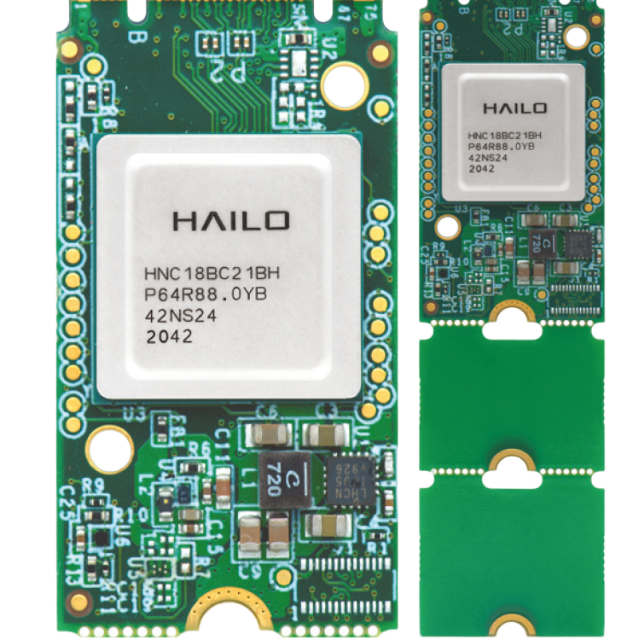
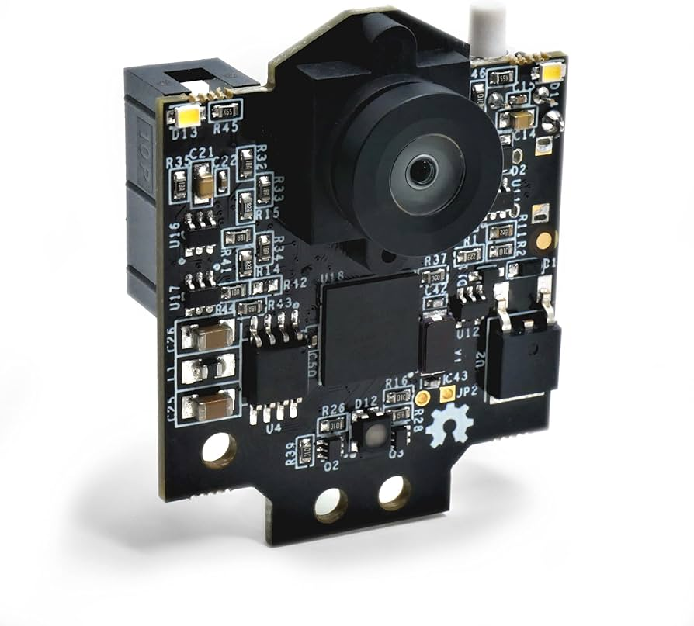
Overview
What:
Crowd density detection and classification via an AI vision model
Runs on a Raspberry Pi with Hailo 8 and Pixy2 camera
Why:
To better understand traffic patterns
Used to avoid crowds
Goals:
Photographing and categorizing crowds by either low, medium, or high density with ??% accuracy every minute

Slide 3
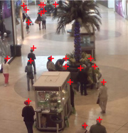
Crowd Size Model
Detecting generalizations of crowds is difficult
We opted for a TensorFlow model that counts the number of people in a frame
Using that count, we can make a generalization about the density
i.e. <10 is low, >10 and <25 is medium, and > 25 is high
Our model trained on open-source dataset for crowd counting with labeled pedestrians
Limited by time, model trained on about 50 annotated images from Mall Dataset
Mall Dataset https://personal.ie.cuhk.edu.hk/~ccloy/downloads_mall_dataset.html

Slide 4
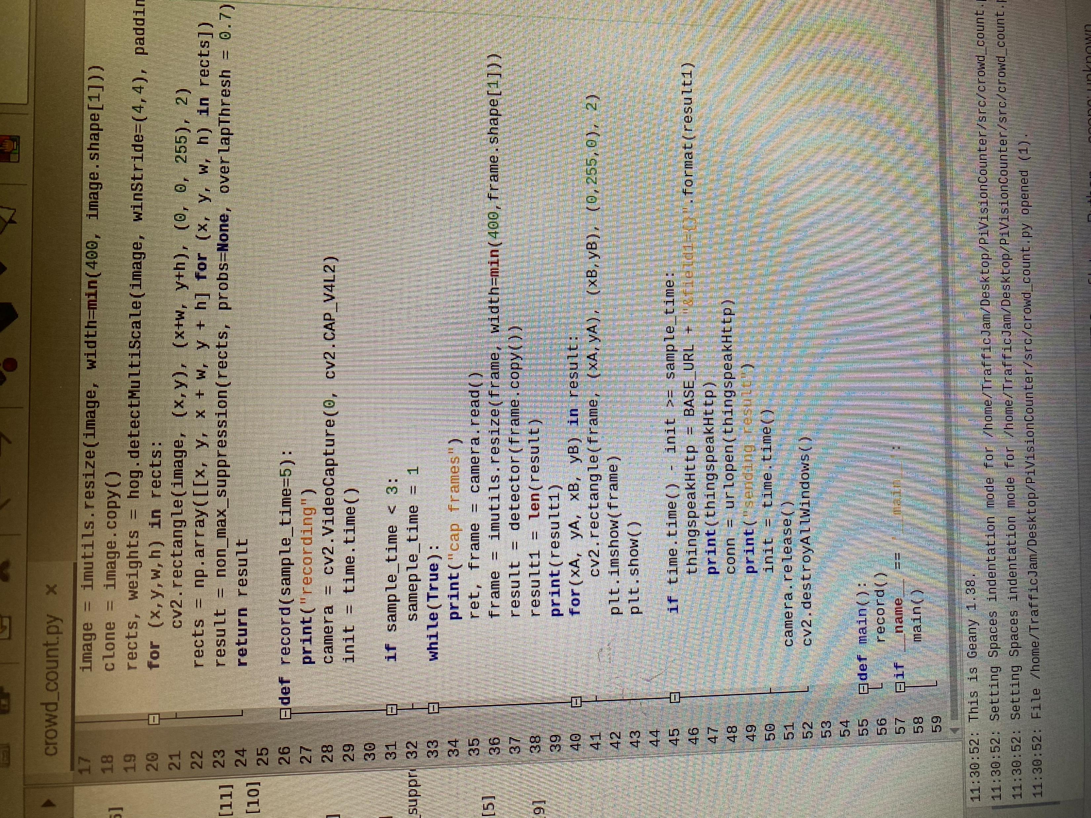
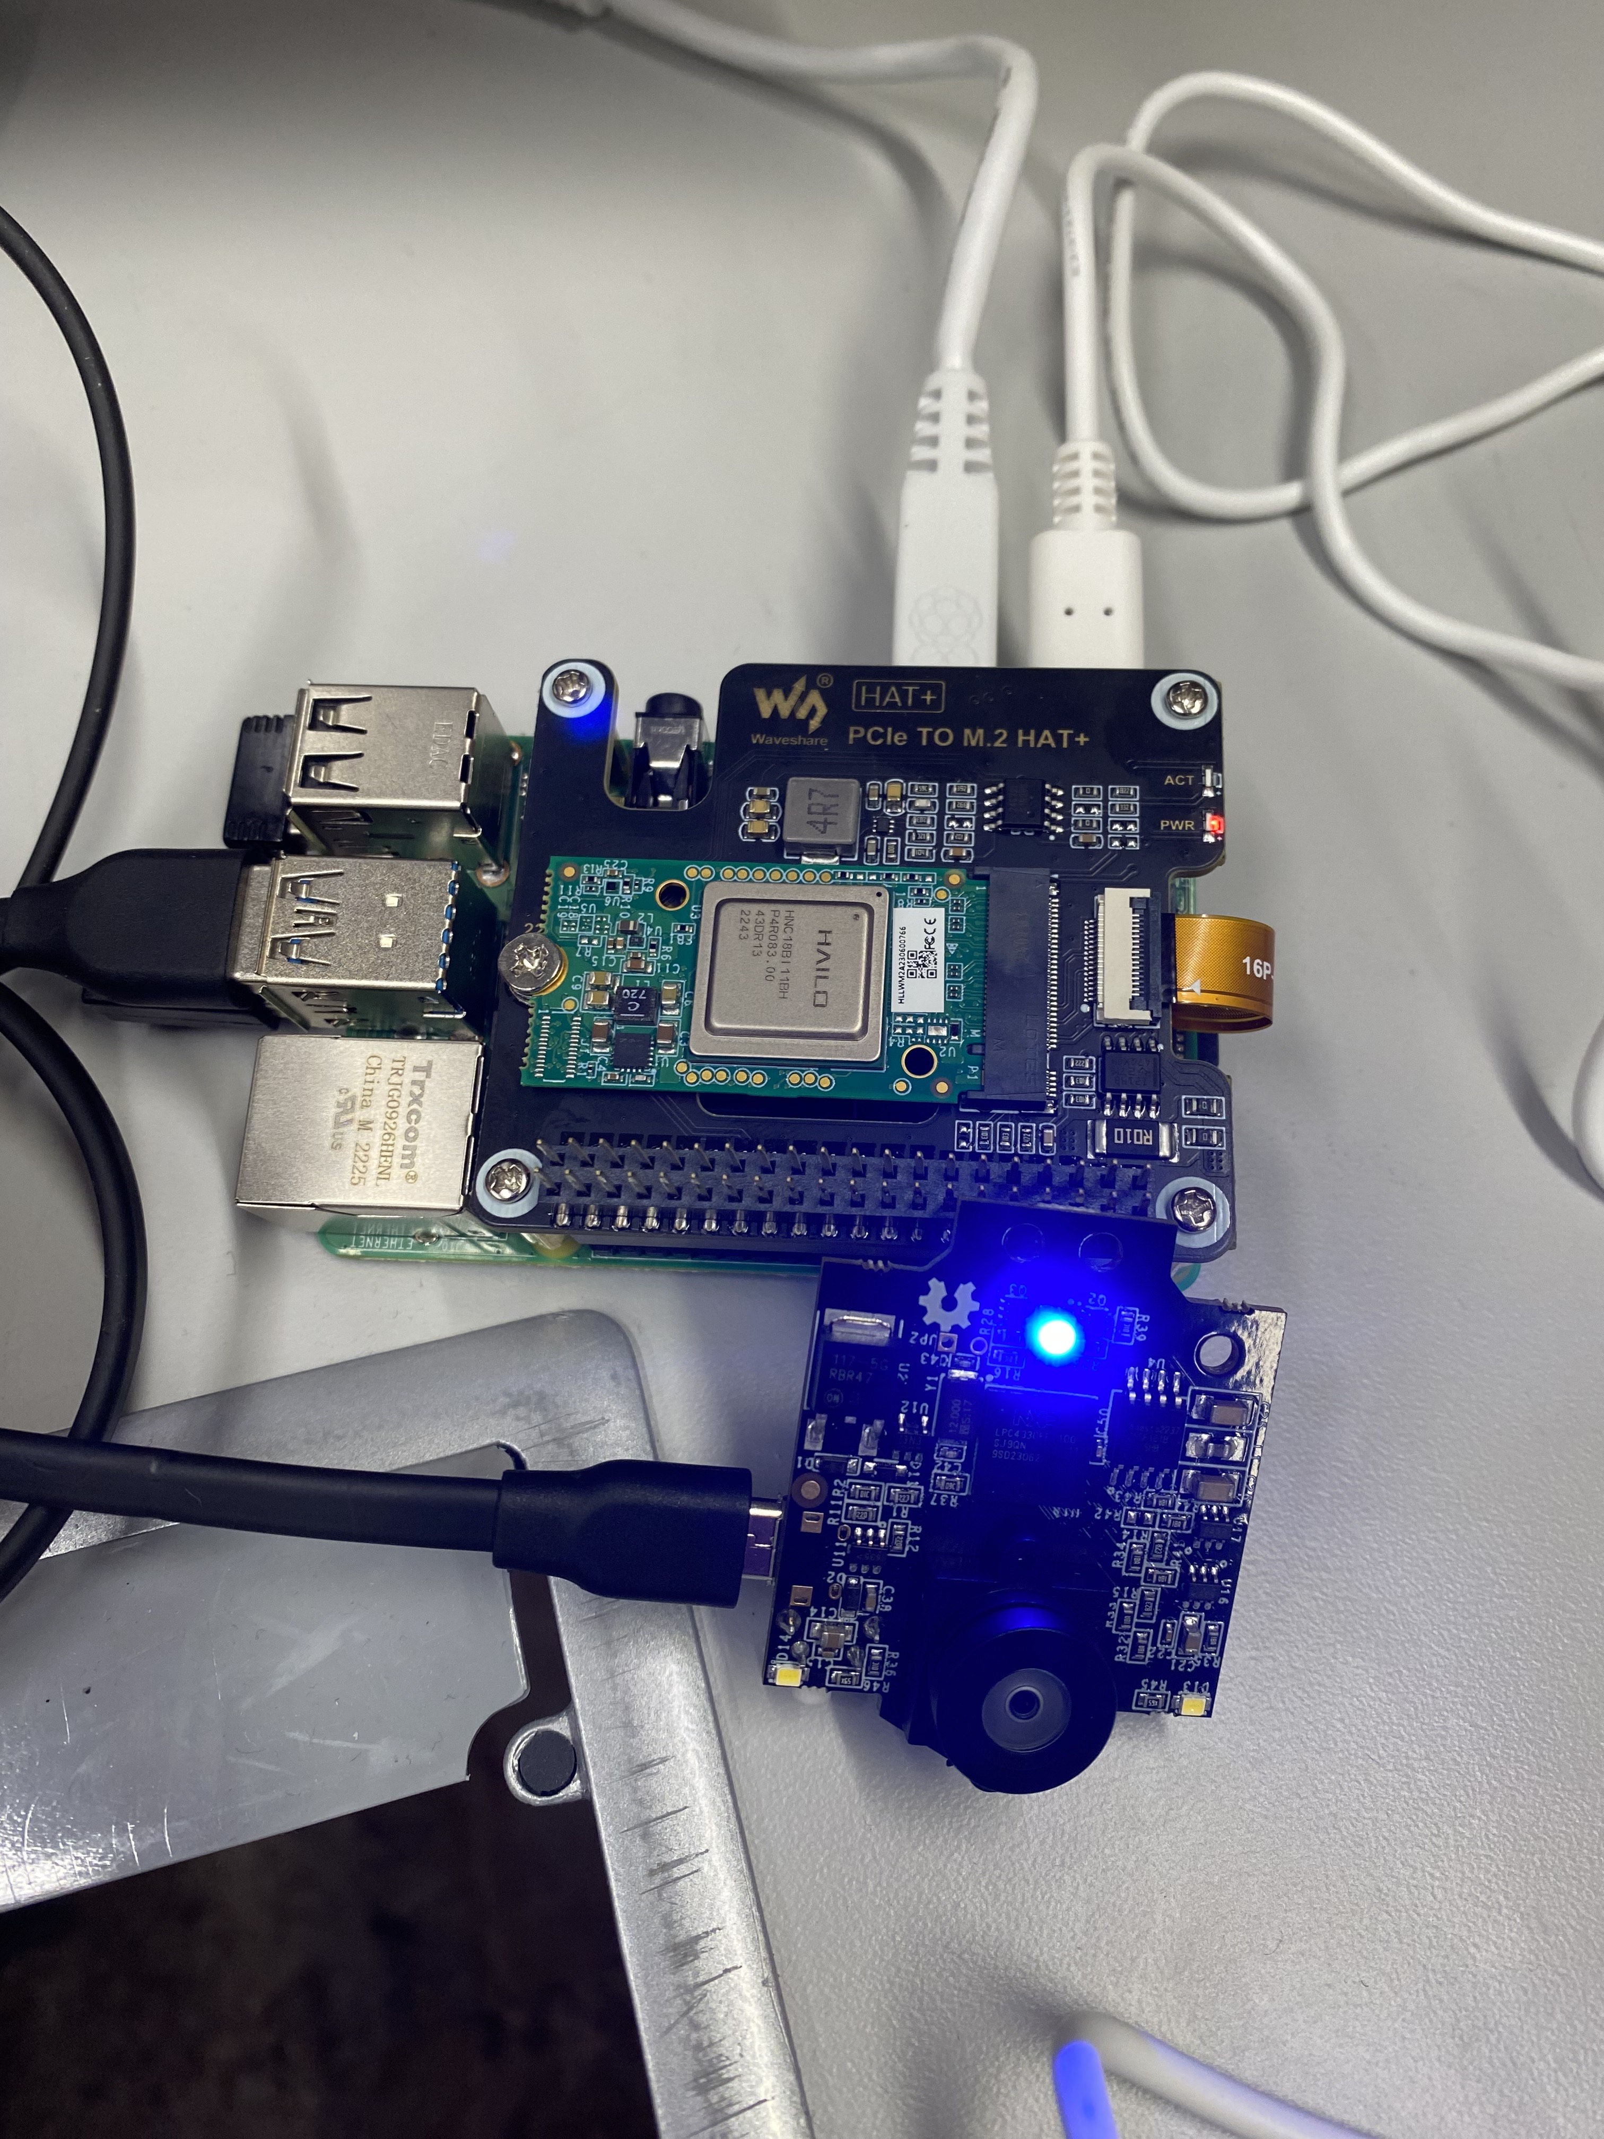
The Setup
TensorFlow Lite conversion to run on Raspberry Pi

Slide 5
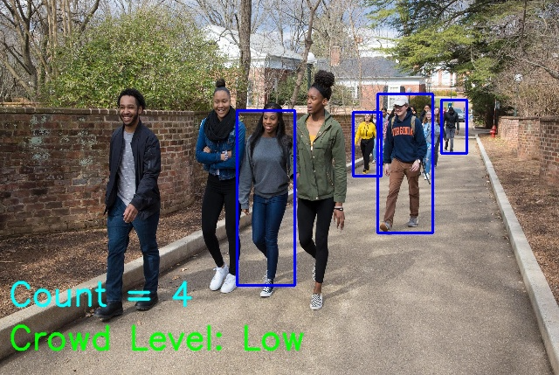
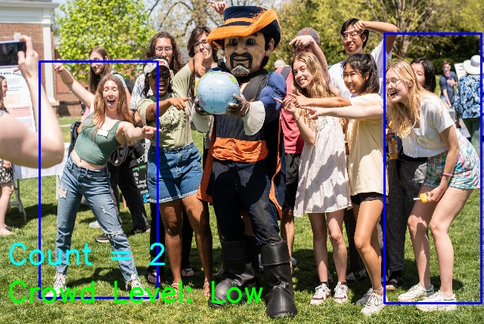
Lab Test Results
Not very great…. Not very accurate

Slide 6
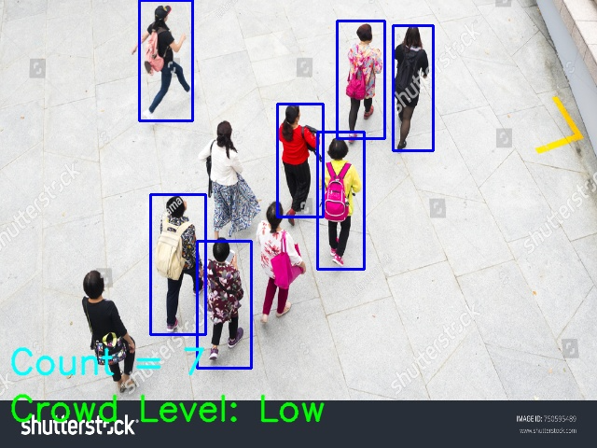
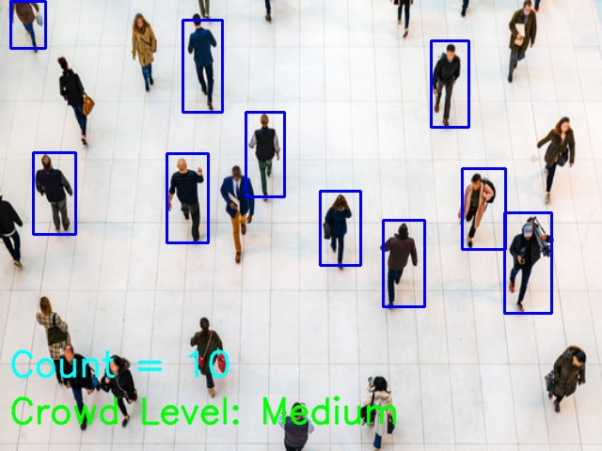
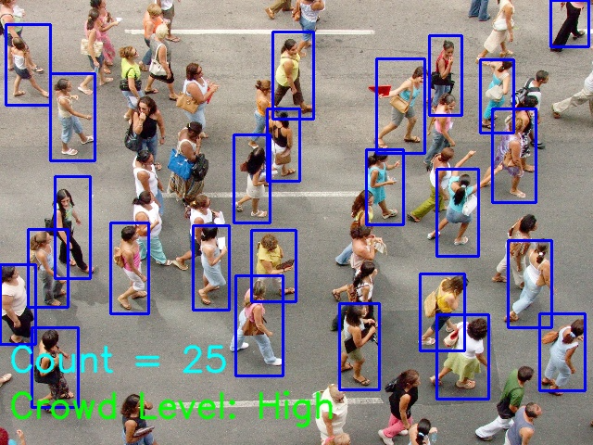
Model Tested on Aerial Photos
Not perfect, but a lot better!

Slide 7
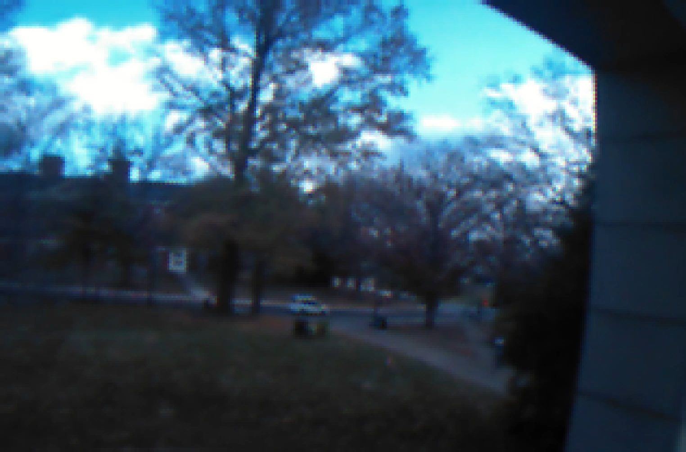
Pixy2 Testing

Slide 8
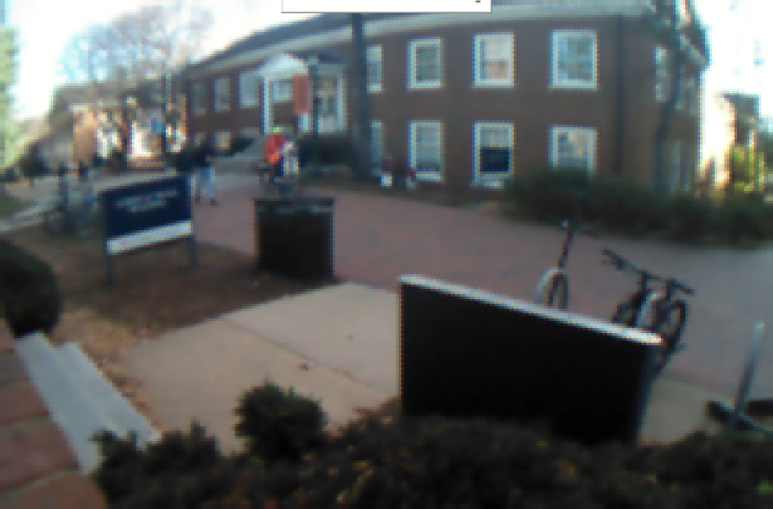
Pixy2 Testing

Slide 9
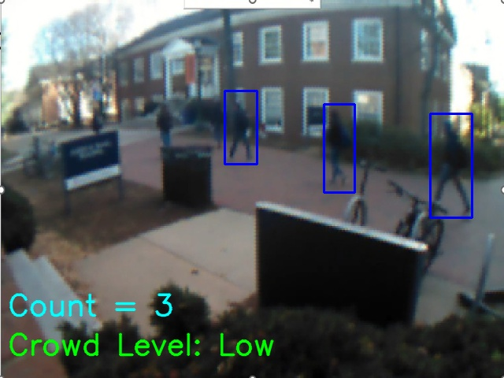
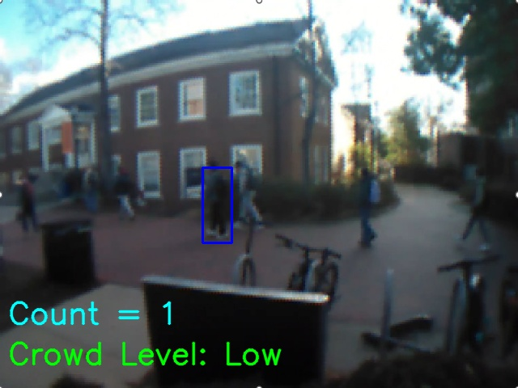
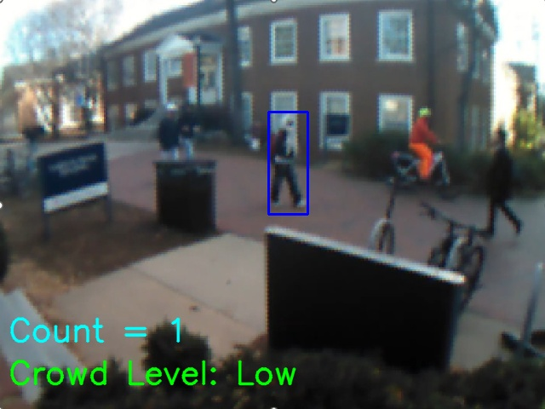
Live Test Results from Pixy2
Not great results, low resolution, unable to get good aerial view

Slide 10
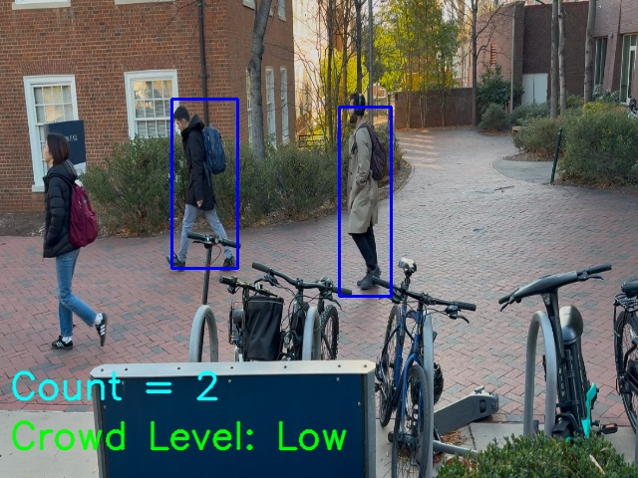
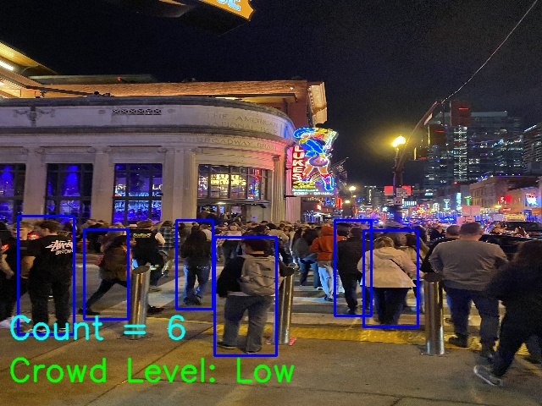
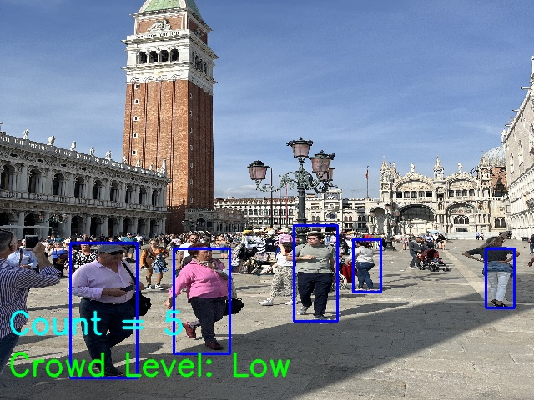
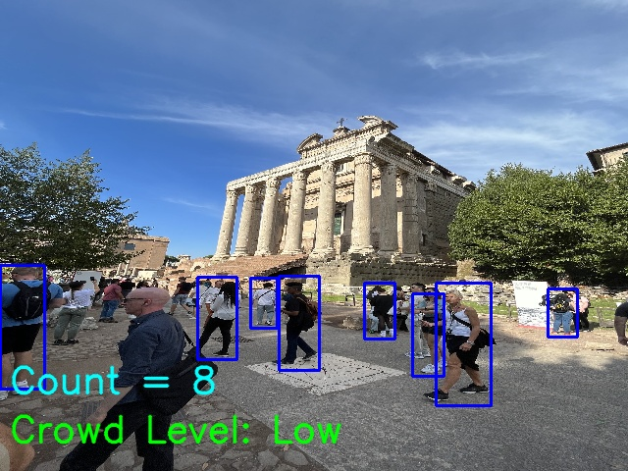
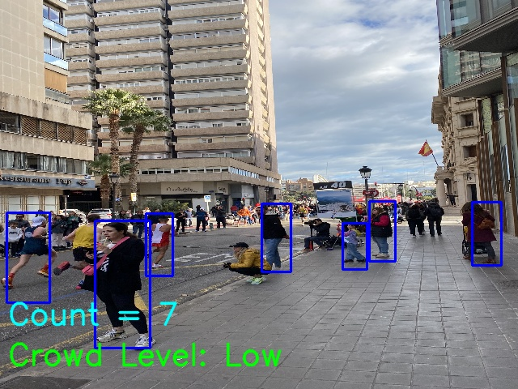
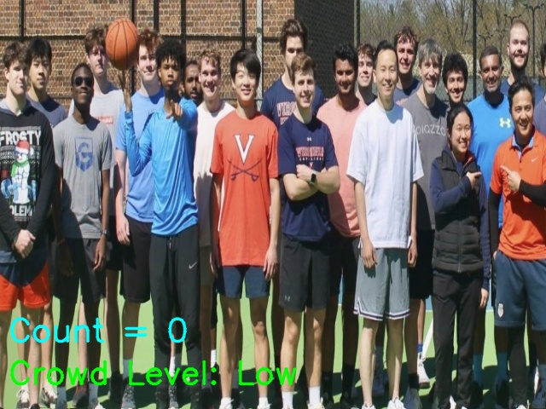
Using Pictures taken from Phone Camera
Small Hall
Crowd in Nashville
Crowd in Venice
Crowd in Rome
Crowd in Valencia
Prof Vs Student Basketball

Slide 11
Conclusion
Model is limited to a very specific workload (aerial view), and can only process clear unobstructed images
With more time, we can use a lot more training data to get a more robust model
AI Accelerator (Hailo 8) has limited support with raspberry pi
Pixy2 Camera resolution is not good enough to capture at long distances
For the Future
We still need more data to determine what thresholds to set for low, medium, and high crowd densities
Implement signals for real time crowd conditions
Capture live feed crowd counting

